Slide 1
Database migration

Slide 2
Purpose of migrating the Database
Hardware or Infrastructure Change
Load Balancing and Scalability
Datacenter Migration.
Migrating from on-premises to cloud.

Slide 3
Ways to migrate database
Database migration
Using CI/CD
Using ETL tools
Using services like Azure Databox/Snowball to migrate terrabytes of data
Export/Import manually

Slide 4
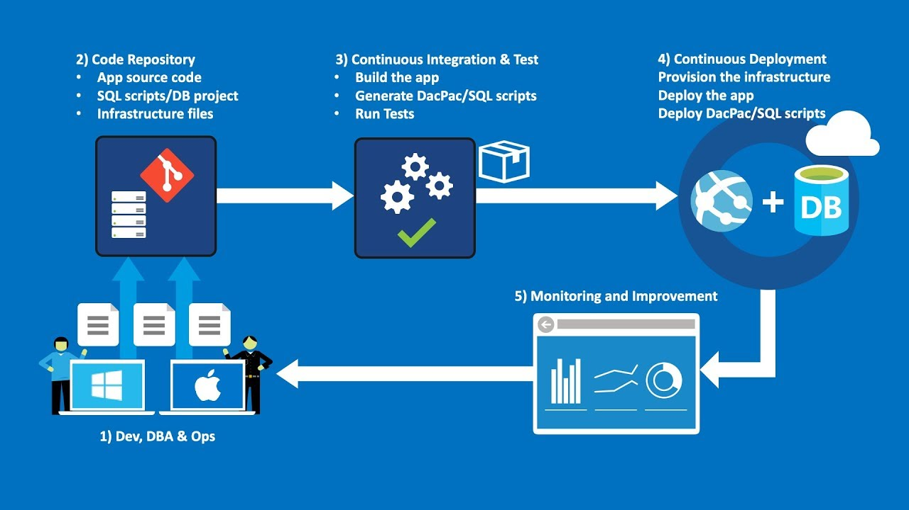
Using CI/CD

Slide 5
Using ETL tools
ETL (Extract, Transform, Load) is commonly used for database migration because it provides a structured and efficient approach to handle the complexities involved in moving data from a source database to a target database.
ETL enables the extraction of data from the source database in a controlled and consistent manner
During database migration, data often needs to be transformed to match the schema and requirements of the target database.
ETL tools provide the capability to perform data transformations, such as data type conversions, data cleansing, data validation, or applying business rules, to ensure the data is compatible with the target database.
Incremental Migration: In scenarios where the source database continues to be operational during migration, ETL processes can be designed to perform incremental data extraction and synchronization. This ensures that only the changes made in the source database after the initial migration are captured and applied to the target database.

Slide 6
Use other services
To migrate bulk data we can use services like Azure Data Box/Snow ball
Order and Prepare the Azure Data Box
Create an Azure Data Box job
Prepare the data for migration
Copy data to the Data Box
Prepare the Data Box for return
Data ingestion and migration in Azure
Clean up and finalize the migration

